Slide 1

https://www.uni-goettingen.de/en/48115.html
Unless I explicitly state otherwise, images and cartoons are created using ChatGPT.
You may use this material free of charge under the terms of the CC BY license. This requires that you provide appropriate attribution to the author: W. Link, University of Goettingen, Germany.
In a few cases, individual images, photographs, or similar material may be subject to a more restrictive Creative Commons license. Where this applies, it is explicitly indicated, and you must comply with the stated license terms for those items.
Please check the license information carefully before reuse. Responsibility for complying with the applicable license terms rests entirely with you.
PopGen_Ch-2
Population Genetics; Hardy-Weinberg-Equilibrium II
1

Slide 2
Sequential Number: #3
UNPLAB-PopGen_Ch-2[HWE II]
2

Slide 3
You already know: Genotype frequency. Gamete frequency. Allele frequency. Random mating. HWE (Hardy-Weinberg-Equilibrium status of a random-mating population).
Keywords of this chapter:
Population. Genotype frequency. Gamete frequency. Allele frequency. Random mating. Hardy-Weinberg-Equilibrium (HWE).
Conditions, Assumptions to allow HWE.
A HWE population is composed of (N=∞) unrelated F1 hybrids (each individual makes a different F1 - whose parents are unknown). ... Not to be confused with a Mendelian F1 (and its genetically identical individuals).
Important Algebra of this chapter:
p² + 2pq + q²; P=p²; H=2pq; Q=q². This is the ‘Algebra’ of Hardy-Weinberg
3

Slide 4
Rational of HWE: “(P=p²)A₁A₁ + (H=2pq)A1A2 + (Q=q²)A₂A₂”. One-locus genotypes.
 | p(A₁)0.64 | q(A₂) 0.36
p(A₁)0.64 | A₁A₁ 0.41 | A₁A₂ 0.23
q(A₂) 0.36 | A₂A₁ 0.23 | A₂A₂ 0.13
Gamete Frequencies aka Allele Frequencies
 | p(A₁)0.6 | q(A₂) 0.4
p(A₁)0.6 | A₁A₁ 0.36 | A₁A₂ 0.24
q(A₂) 0.4 | A₂A₁ 0.24 | A₂A₂ 0.16
 | p(A₁)0.8 | q(A₂) 0.2
p(A₁)0.8 | A₁A₁ 0.64 | A₁A₂ 0.16
q(A₂) 0.2 | A₂A₁ 0.16 | A₂A₂ 0.04
 | p(A₁)0.9 | q(A₂) 0.1
p(A₁)0.9 | A₁A₁ 0.81 | A₁A₂ 0.09
q(A₂) 0.1 | A₂A₁ 0.09 | A₂A₂ 0.01
Take note:
Q, the frequency of the rare homo-zygous genotype A₂A₂, is extremely rare if q(A₂)is small.
…
Genotype Frequencies
1
If the allele frequencies do not change from generation to generation, and if mating of gametes is at random, then this statement: “ P+H+Q correspond to p²+2pq +q²; P=p²; H=2pq; Q=q² “ ... is expected to be true and realized in each generation. Therefore these (from-allele-frequencies-deduced) genotype frequencies P; H; Q are expected to be “stable”, to be the same, in all upcoming generations. This is the Hardy-Weinberg-Equilibrium status of a population. It is a theoretical, stable status as to these frequencies. By the way: As soon as the random mating took place ‘the first time’, HWE applies. Instantly, the genotypes occur in frequencies P=p² plus H=2pq plus Q=q².
2
As said above: ‘If the allele frequencies do not change ... and if random mating’. Mating may be non-random. Alleles’ frequencies may change across generations because of Selection or Mutation or Migration or Drift.
Drift? The array of the actually mating gametes is only a sample of ‘all’ gametes. If the sample is not large, then it can not perfectly represent the allele frequencies of the parent generation (from with the gametes come) – hence causing erratic change in allele frequency (and hence in genotype frequency).
4

Slide 5
Rational of HWE: “(P=p²)A₁A₁ + (H=2pq)A1A2 + (Q=q²)A₂A₂”. One-locus genotypes.
 | p(A₁)0.64 | q(A₂) 0.36
p(A₁)0.64 | A₁A₁ 0.41 | A₁A₂ 0.23
q(A₂) 0.36 | A₂A₁ 0.23 | A₂A₂ 0.13
 | p(A₁)0.6 | q(A₂) 0.4
p(A₁)0.6 | A₁A₁ 0.36 | A₁A₂ 0.24
q(A₂) 0.4 | A₂A₁ 0.24 | A₂A₂ 0.16
 | p(A₁)0.8 | q(A₂) 0.2
p(A₁)0.8 | A₁A₁ 0.64 | A₁A₂ 0.16
q(A₂) 0.2 | A₂A₁ 0.16 | A₂A₂ 0.04
 | p(A₁)0.9 | q(A₂) 0.1
p(A₁)0.9 | A₁A₁ 0.81 | A₁A₂ 0.09
q(A₂) 0.1 | A₂A₁ 0.09 | A₂A₂ 0.01
Take note:
Q, the frequency of the rare homo-zygous genotype A₂A₂, is extremely rare if q(A₂)is small.
…
1
If the allele frequencies do not change from generation to generation, and if mating of gametes is at random, then this statement: < P+H+Q correspond to p²+2pq +q²; P=p²; H=2pq; Q=q² > ... is expected to be true and realized in each generation. Therefore these (from-allele-frequencies-deduced) genotype frequencies P; H; Q are expected to be “stable”, to be the same, in all upcoming generations. This is the Hardy-Weinberg-Equilibrium status of a population. It is a theoretical, stable status as to these frequencies. By the way: As soon as the random mating took place ‘the first time’, HWE applies. Instantly, the genotypes occur in frequencies P=p² plus H=2pq plus Q=q².
2
As said above: ‘If the allele frequencies do not change ... and if random mating’. Mating may be non-random. Alleles’ frequencies may change across generations because of Selection or Mutation or Migration or Drift.
Drift? The array of the actually mating gametes is only a sample of ‘all’ gametes. If the sample is not large, then it can not perfectly represent the allele frequencies of the parent generation (from with the gametes come) – hence causing erratic change in allele frequency (and hence in genotype frequency).
5

Slide 6
This here is so very important – so I just say it again in a slightly different wording.
 | p(A₁) ♂ | q(A₂) ♂
p(A₁) ♀ | A₁A₁ | A₁A₂
q(A₂) ♀ | A₂A₁ | A₂A₂
♂
The Hardy-Weinberg-Principle, or name it Hardy-Weinberg-Law says:
Given some conditions hold (‘random mating’ and ‘no change of the allele frequencies of a population’), then you can ...
1 .. calculate from two data (frequency of allele p(A1) and allele q(A2) in a population) the result of three parameters in that population (frequencies of genotypes: P(A1A1), H(A1A2), Q(A2A2) ... as P=p²; H=2pq; Q=q²). This sounds like a magic increase of information. Yet. You start honestly with three information, since you add this third info: Random Mating.
♀
2 Given these conditions (random mating, no change ...), the population will reach these so-called HWE-frequencies of genotypes (P + H + Q = p² + 2pq + q² = 1) after just one generation of random mating, whether these specific genotype frequencies had already been realized in the generation before or not.
The population will show these HWE frequencies for all coming generations
(well; until the ‘conditions’ will not be fulfilled any more).
6
Current
Next Generation
Generation after next
….
Forever ….

Slide 7
This here is so very important – so I just say it again in a slightly different wording.
 | p(A₁) ♂ | q(A₂) ♂
p(A₁) ♀ | A₁A₁ | A₁A₂
q(A₂) ♀ | A₂A₁ | A₂A₂
♂
The Hardy-Weinberg-Principle, or name it Hardy-Weinberg-Law says:
Given some conditions hold (‘random mating’ and ‘no change of the allele frequencies of a population’), then you can ...
1 .. calculate from two data (frequency of allele p(A1) and allele q(A2) in a population) the result of three parameters in that population (frequencies of genotypes: P(A1A1), H(A1A2), Q(A2A2) ... as P=p²; H=2pq; Q=q²). This sounds like a magic increase of information. Yet. You start honestly with three information, since you add this third info: Random Mating.
♀
2 Given these conditions (Random Mating, no change ...), the population will reach these so-called HWE-frequencies of genotypes (P + H + Q = p² + 2pq + q² = 1) after just one generation of Random Mating, whether these specific genotype frequencies had already been realized in the generation before or not.
The population will show these HWE frequencies for all coming generations
(well; until the ‘conditions’ will not be fulfilled any more).
Geoffry Harold Hardy, British Mathematician (1877-1947)
Wilhelm Weinberg, German Medical Doctor and Geneticist (1862 -1937)
7

Slide 8
Detailed conditions to reach and keep the Hardy-Weinberg Equilibrium frequencies in a population.
 | p(A₁)0.6 | q(A₂) 0.4
p(A₁)0.6 | A₁A₁ 0.36 | A₁A₂ 0.24
q(A₂) 0.4 | A₂A₁ 0.24 | A₂A₂ 0.16
The Hardy-Weinberg Principles say: If several ‘specific conditions’ are met in the ‘live’ of a population, then the population will not change genetically.
Especially the frequency of genotypes that occur each new generation will not change. Violating the ‘specific conditions’ will cause some change (evolution) of the population.
Nota bene: we talk here about one-locus genotypes. See later the so-called Generalized Hardy-Weinberg-Equilibrium for multi-loci-genotypes (such as A1A1/B1B1/C2C2...).
The literature has these primary assumptions (‘specific conditions’):
Mating is Random Mating of gametes (panmixia); do you want to ponder about the difference between random mating of individuals and random mating of gametes?
The size of the population (number of parents, number of mating gametes) is infinitely large.
No migration.
No mutation.
No selection (neither between individuals nor between gametes).
The literature (e.g. ISBN 1605351539) has these secondary conditions:
Diploid species (i.e. haploid gametes). Sexual, hermaphroditic species (no difference between females and males).The genetic locus that is considered is not on a sex chromosome. Generations do not overlap (e.g. annual plants). There are but two alleles at this locus (ponder about Hardy-Weinberg in case of 3 or more alleles per locus).
8

Slide 9
1
1
HWE: Genotype frequency deviate from
allele frequency.
As we consider different allele frequen-cies, the genotype frequencies differ accordingly.
In Hardy-Weinberg-Equilibrium, the gap between allele and genotype frequency (e.g. between p and P) varies.
Absolutely, P(A₁A₁) deviates most from p(A₁) at p=0.5 (the gap Δ = 0.25).
Relatively, P(A₁A₁) deviates most from p(A1) near p(A₁)=0 which is near q(A₂)=1.
E.g., at p(A₁)=0.01, P=p²= 0.0001.
This says:
The genotype A₁A₁ is 100-fold rarer (1 in 10.000) than the allele A₁ (1 in 100).
‚Square of rare is very rare‘.
◄ HWE genotype frequency P ►
◄ Allele frequency p(A₁) ►
P(A₁A₁)
Δ = 0.25
0
◄ Allele frequency q(A₂) ►
1
0
9

Slide 10
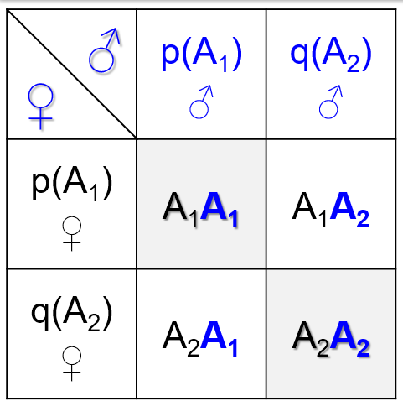

HWE is so very important ;-)
p² A₁A₁
p A₁
haploid
diploid
2pq A₁A₂
q A₂
q² A₂A₂
Meiosis
10

Slide 11
1.0
Frequencies of genotypes
0.5
0.0
0.5

Slide 12
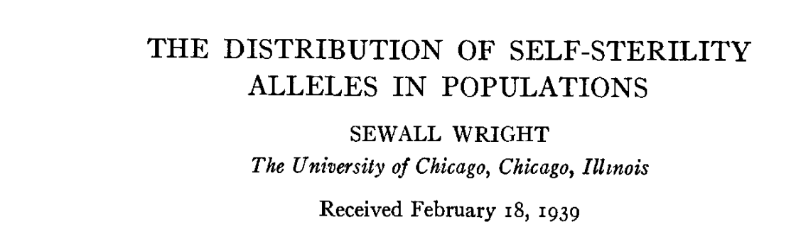
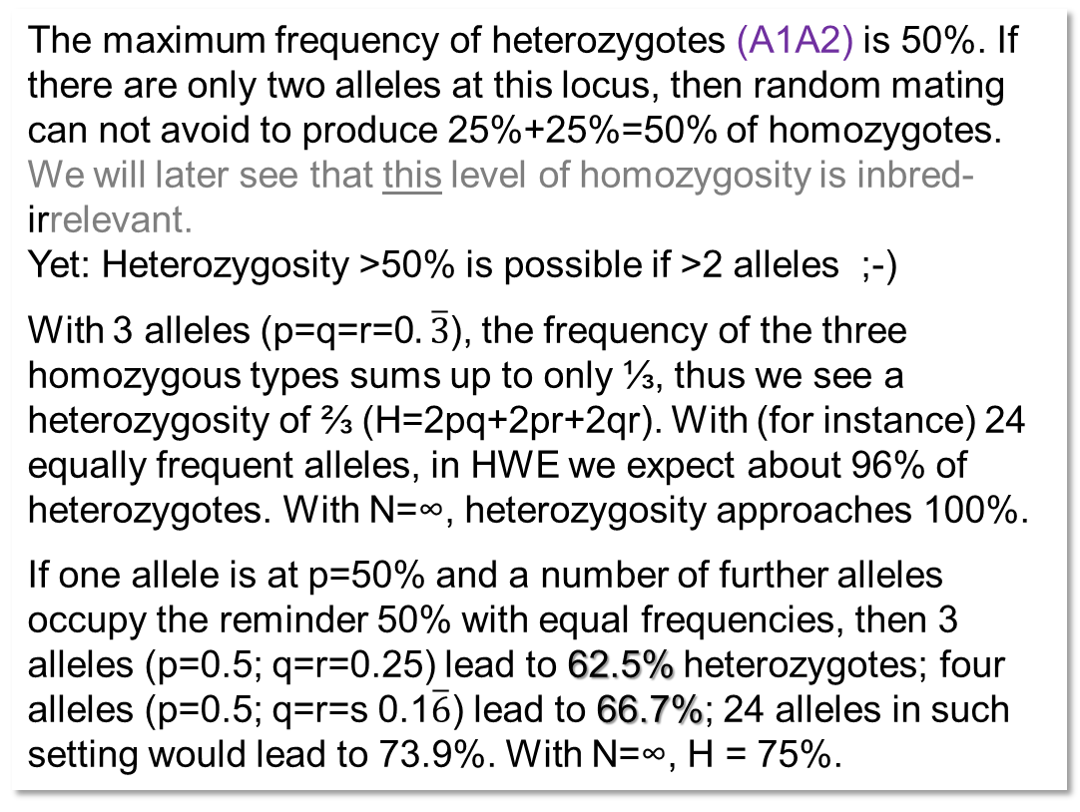
1.0
Frequencies of genotypes
0.5
0.0
0.5

Slide 13

We need terms to communicate about Population Genetics.
A sunflower (H. annuus, 2n=34) population
A current generation of a Population is a group of individuals that jointly reproduce and ‘make’ the next generation of the population. Typically, cross-breeding is assumed; yet, any type of reproduction may apply (one assumes that at least a small extent of crossing between the individuals happens; even if vegetative propagation or self-fertilization prevails).
Typically, each Individual in a such diverse population is thought to be (to have) a unique (private) Genotype (meant as genome-wide ‘genotype’). Saying ‘genotype’ is then like saying ‘individual’.
● Genotype Frequency (now: one-locus genotype) is the frequency (% or on 0-1 scale) of genotypes. Example: Frequency of ‘maintainer’ genotype (‘rf-rf’; maintainer: see later).
● Gamete frequency: Frequency of ‘gamete-types’ in a population. E.g. 64% of gametes carry the ‘rf’ allele.
With one gene just once in genome (not always true) and if gametes are haploid (not always true), Gamete Frequency (64% pollen with ‘rf’) is the same as ● Allele Frequency (64% ‘rf’). :-)
● Random mating: Random joining of male and female gametes. ● No Selection: All genotypes have same basic probability to be parents. ● No Migration: Population is ‘closed’. ● No Drift: Number of parents is very large. So very large that (if parents are unselected) the sum of their gametes is fully representative of the former generation (very large means N=∞).
13

Slide 14



A deeper appreciation of what this is, a HWE-population
In a HWE population, there are no matings between genetically related (‚co-ancestry‘) individuals. But wait … there must be fill-sib siblings! And then, there must be for instance cousins! Are there no such matings, if mating is really ‚at random‘?
The population has N=∞ individuals. Therefore, the probability of any specific type of mating is zero. If, for instance, one plant had N siblings in the current generation, then the probability to mate with any of them was P = N/∞ which is .. zero. ☺
=> All mating is between unrelated individuals. Therefore, all offspring is non-inbred.
Yeah, this is a text-book concept. Theory.
So: Such HWE is the reference for zero inbreeding. By definition. Of course we can take say 2 individuals from the HWE-population and create a new HWE-population. Then we either define the new, narrow population as new reference (we forget about the initial HWE population). Or we keep the initial population as reference, yet, then the more narrow new population is – although nicely in its own HWE equilibrium – not the reference. It would be a bit inbred - since created via only two initial individuals. It would have this inbreeding level: F=1/4 (see later) … if taking its ancestral population as the reference for what ‘non-inbred’ may mean.
14

Slide 15
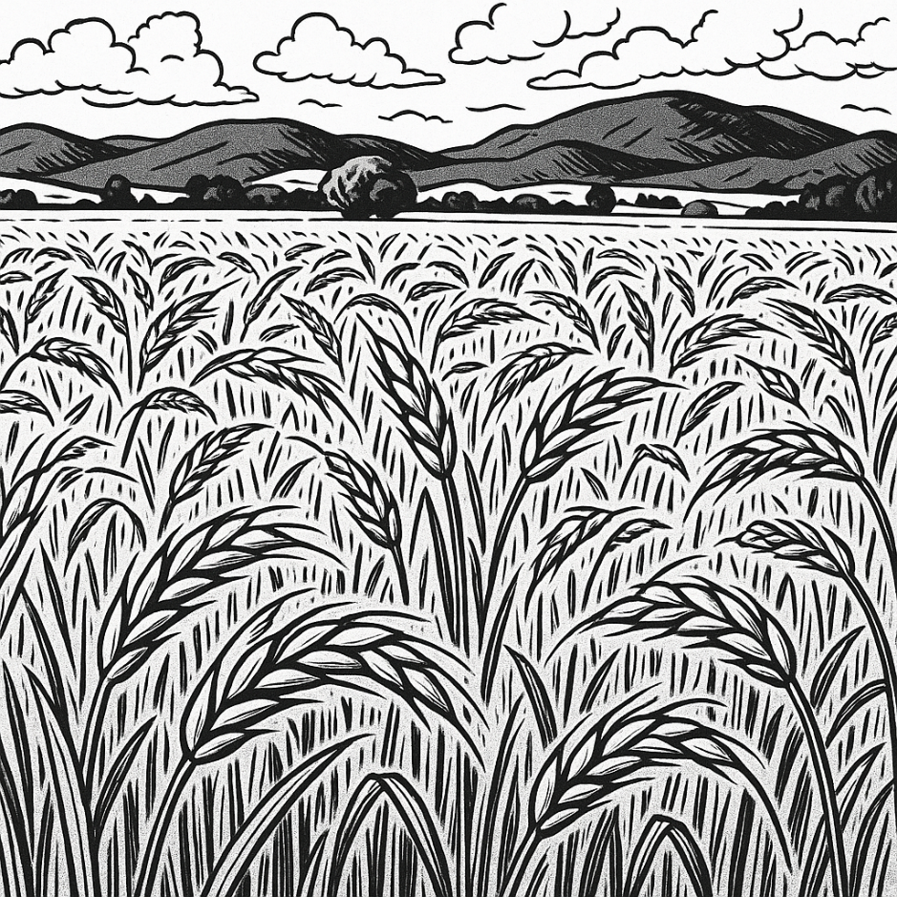
A deeper appreciation of what this is, a HWE-population
Again: Each member of a HWE population is non-inbred. They are of course genetically different, such as AA or Aa or aa. Seen across all loci, each individual is rather unique, the number of loci is so high that not easily you find in the N=∞ individuals a second one with the exact same genotype.
Here, it is nothing wrong in addressing each plant as F1. The HWE population is a population of endless many (N=∞) F1-individuals.
Be cautious: This is different from Mendel’s F1.
A Mendelian F1 is … (non-inbred, i.e. highly heterozygous, and …) ¡UNIFORM.
A Mendelian F1 is uniform because (!) its parents are homozygous. Its mother produced only one type of gametes, its father produced only one type of gamete, all their F1-offspring individuals are (non-inbred and) same, genetically identical. The same gamete-type that is mass-produced by this Mendelian mother line is – of course – existing as single, unique gamete in the HWE-population, too (reminder: N=∞). Same for father. Each Mendelian F1 that we imagine exists in the HWE population as unique cross between two gametes (because all imaginable gametes exist).
Yet: Such cross exists in the HWE-population as rare (probably unique) individual, not as (arbitrarily) many plants as we see it in the uniform (homogeneous) Mendelian F1-generation.
15

Slide 16
A deeper appreciation of what this is, a HWE-population. Read until you like it!
A HWE population
Gametes  F1 offspring
F₁
F₁
F₁
F₁
F₁
Mendelian cross
Gametes  F1 offspring
F₁
F₁
F₁
F₁
F₁
16

Slide 17

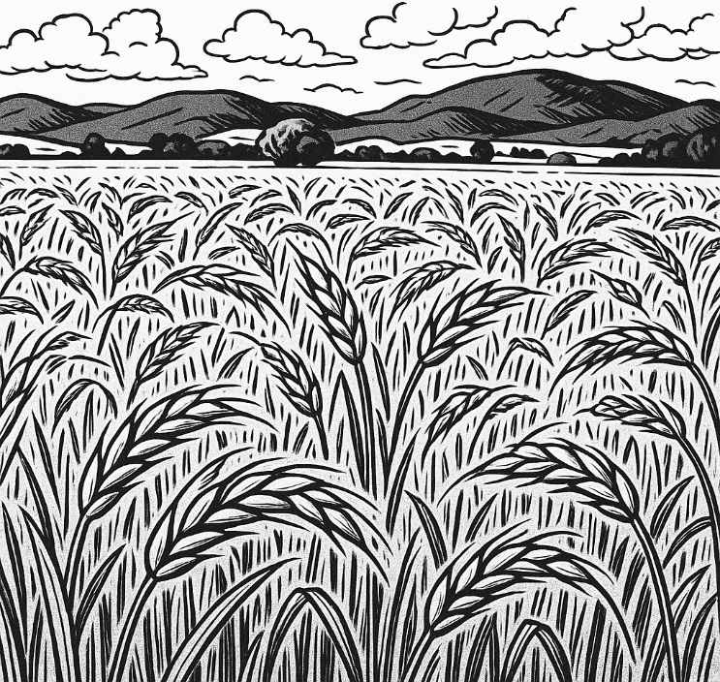
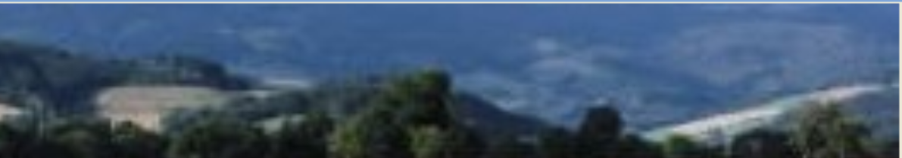
A deeper appreciation of what this is, a HWE-population. Read until you like it!
A HWE population
Gametes  F1 offspring
The HWE population is a mixture of non-inbred (name-them F1) individuals, each of them is a unique individual-genotype (if you just for instance self-fertilize any of them, you get a very normal Mendelian F2 generation).
A Mendelian F1 is a generation with one-or-several-or-many individuals, all with same genotype. This F1 genotype is just one of the endless many non-inbred individual-genotypes that one can find in the HWE Reference Population.
A Mendelian F1 can be produced and be re-produced, because with the parents, we have immortal gamete-re-producers. A Mendelian F1 is called ‘immortal’ F1.
An individual of the HWE population (name it ‘mortal’ F1) can not be reproduced and not be produced at will, because the female and male gametes from which it came vanished in the mating*.
… it is even not easy to see, in the HWE-’mortal’-F1, exactly which genes and haplotypes came actually from its mother and from its father ;-)
F₁
F₁
F₁
F₁
F₁
Mendelian cross
Gametes  F1 offspring
F₁
*and, if these two gametes received any kind of identity, then only via the identity of the zygote (in the plant) they made.
F₁
F₁
F₁
F₁
17

Slide 18
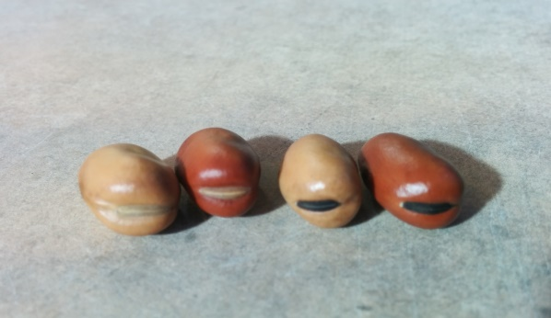
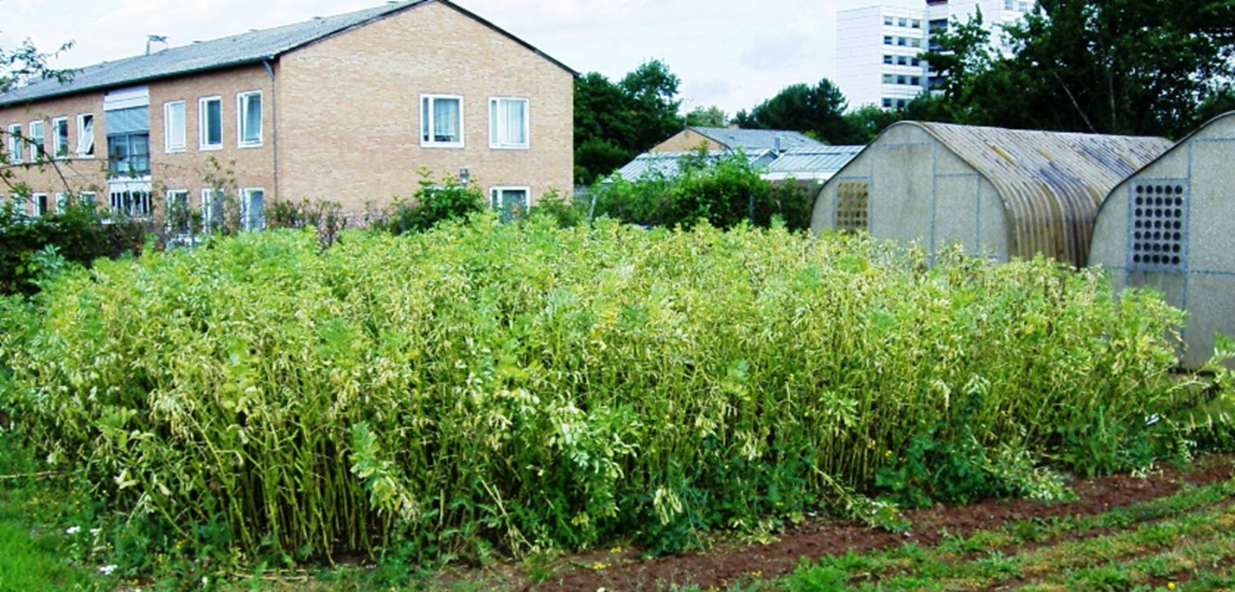
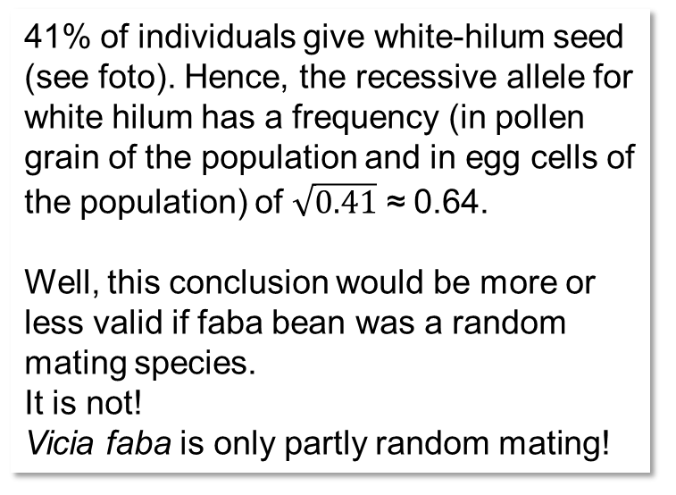
Rehearsal, application. Here, a population of faba bean plants and a monogenic trait.
41% of individuals give white-hilum seed (see foto). Hence, the recessive allele for white hilum has a frequency (in pollen grain of the population and in egg cells of the population) of $\sqrt{0.41}$ ≈ 0.64.
Well, this conclusion would be more or less valid if faba bean was a random mating species.
It is not!
Vicia faba is only partly random mating!
© WL
With the usually (more or less) s=50% of self-fertilization and hence only about 50% of random outcrossing (you see, a major deviation of random mating) …
and with the 41% of homozygous-recessive (say „aa“*) genotypes, the frequency of p(a) is ~57.3% in the population, it is not ~64%.
In such partial allogamy (mixed mating), we expecte Q(aa)= q² + {s/(2-s)} pq.
This is quite different from Q(aa)= q² as expected with s=0, which means random mating.
The details are not given here. Yet, you see what may happen if we deviate from the strict HWE assumptions.
*‘A’ and ‘a’ do not want to say anything else than ‘A₁’ and ‘A₂’ ... obviously ‘a’ is the recessive allele.
18

Slide 19
From here, you may go to UNPLAB-PopGen_Ch-3[Inbreeding]
19

